Slide 1
Principles of Information Systems (13th Edition)
Chapter/Unit 1-2:
Careers in Information Systems

Slide 2

Careers in Information Systems
A successful IS worker must:
  Enjoy working in a fast-paced, dynamic environment.
  Meet deadline and solve unexpected challenges.
  have good communication skills.
  Have solid analytical and decision-making skills.
  Develop effective teamwork and leadership skills.
  Be adept at implementing organization changes.
  Be prepared for life-long learning in the rapidly changing IS field.

Slide 3

Careers in Information Systems
Technical skills for IS workers:
  Capability to analyze large amounts of structured and unstructured data: Data scientist.
  Ability to design/build applications for mobile and wired devices: System analyst.
  Programing and application development skills: Programmer.
  Technical support expertise.
  Project management skills.
  Knowledge of networking and cloud computing.
  Ability to audit systems and implement security measures.
  Web design skills.
  Knowledge of data center operations.

Slide 4

Roles, Functions, and Careers in IS
In addition to technical skills, IS professionals need:
  Skills in written and verbal communication.
  Understanding of organizations and the way they operate.
  The ability to work with people and in groups.

Slide 5

Working in Team
IS careers involve working in project teams that can consist of many positions and roles.
It is always good for IS professionals to:
  Have good communications skills and the ability to work with other people.

Slide 6
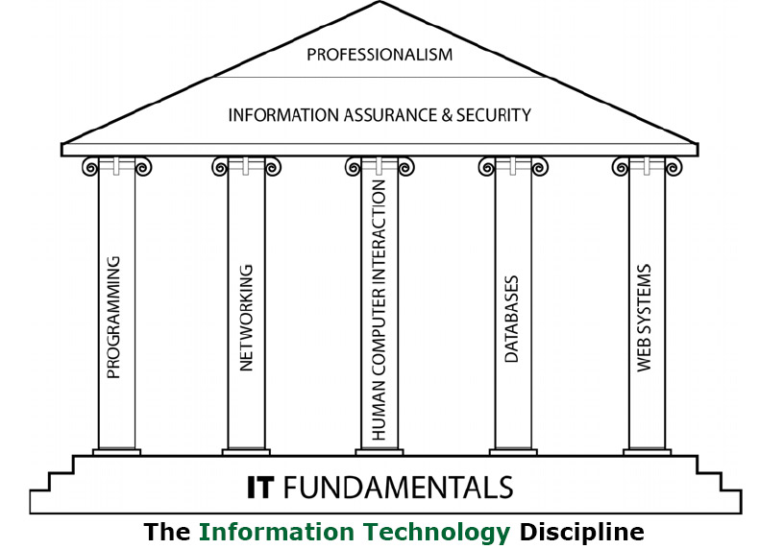
Build Skillset, Mindset, and Knowledge to Capture Career Opportunities and Manage Information Resources

Slide 7

IS Job Titles and Functions
Chief information officer (CIO) employs IS resources and personnel to help the organization succeed.
Senior IS Manager:
  VP of IS.
  Chief technology officer (CTO)
  Central role to communicate with other areas of the organization to determine business needs for IS.

Slide 8
IS Job Titles and Functions: Operations Roles
Data center manager: Responsible for the maintenance and operation of the organization’s computing facilities.
System operator: Run and maintain IS resources.
IS security analyst: Responsible for maintaining security and integrity of organizations’ systems and data.
Local area network (LAN) administrator: Set up and manage computer network hardware, software, and security processes.

Slide 9
IS Job Titles and Functions: Development Role
Software developer: Write software that customers and employees use.
Systems analyst: Consult with managers and users, as well as convey system requirements to software developers and network architects.
Programmer: Convert a program design developed by a systems analyst or software developer into computer languages.
Web developer: Design and maintain Web sites, including site layout and function, to meet client’s requirements.

Slide 10
IS Job Titles and Functions: Support
Database administrator (DBA): Design and set up databases to meet organizational needs.
System support specialist: Respond to telephone calls, email, and other inquiries from users.

Slide 11
Other IS Careers
Consulting opportunities.
Computer training.
Computer and computer-equipment sales.
Computer repair and maintenance.
Support services.
Employment with technology companies.
Entrepreneurial ventures in IS.

